Slide 1




UE21CS320A – Capstone Project Approval
Project Title : Real-Time Identification and Addressing of Hateful
Content in Online Conversations
Project ID : 66
Project Guide: Dr. Kamatchi Priya L

Slide 2

MEET THE TEAM

Slide 3


INDEX
1
PROBLEM STATEMENT
2
PREREQUISITE INSIGHTS
3
CASE STUDY
4
SCOPE AND NOVELTY
5
FEASIBILITY STUDY
6
MODELS UNDER CONSIDERATION
7
DATA SET
8
EXPECTED DELIVERABLES
9
CHALLENGES AND APPLICATIONS
10
TIMELINE

Slide 4

PROBLEM STATEMENT
Real-Time Identification and Addressing of Hateful Content in Online Conversations
WHY?
Rise of Hateful Content:
With the increasing popularity of social media, there has been a significant rise in the prevalence of toxic content, including hate speech, harassment, and offensive language.
Challenges in moderation:
Social media platforms struggle to effectively moderate and filter out toxic content due to the sheer volume of user-generated data and the evolving nature of online language.
Complexity of Toxicity
Toxic content can manifest in various forms, including explicit language, subtle sarcasm, and cultural nuances, making it a complex challenge for automated systems to identify and classify accurately.

Slide 5
PREREQUISITES INSIGHTS
Euphemism
A euphemism is like using a nicer or softer way to say something that might be uncomfortable or harsh.
Characteristics of Euphemism:
Indirect Language
Coded Language
Context Dependence
Contextual Analysis
Context analysis deals with understanding the entire conversation, user history, cultural nuances, and real-time dynamics to accurately determine whether a statement is toxic.

Slide 6
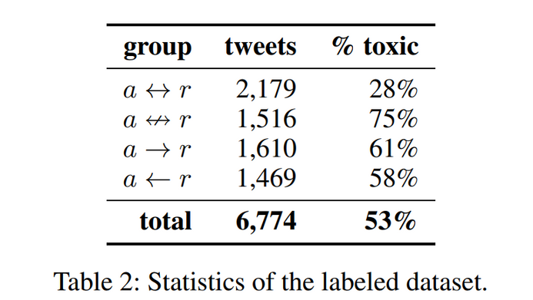
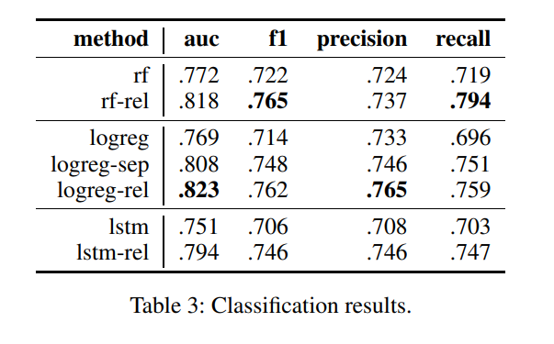
CASE STUDIES
RESEARCH PAPER 1
https://ojs.aaai.org/index.php/ICWSM/article/view/7366/7220
Context is taken into consideration
Models used : Random forest , Logistic regression, LSTM
PROBLEMS
Down grades importance of context to classify the toxicity
Does not address how people surpass existing model

Slide 7
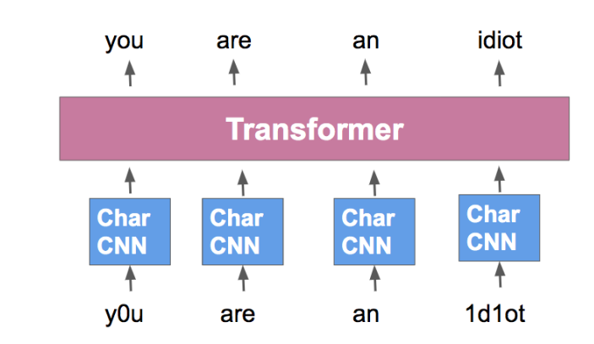
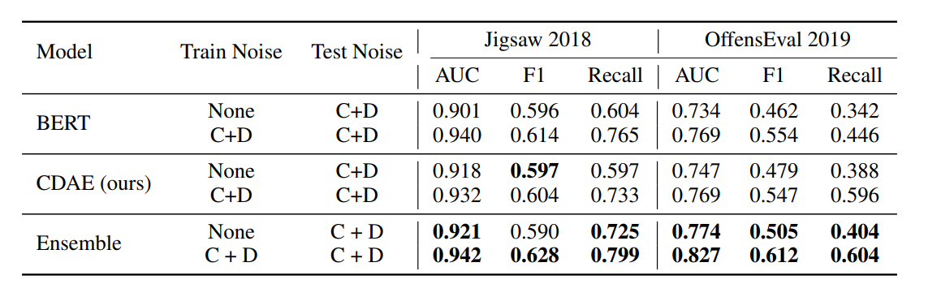
RESEARCH PAPER 2
https://arxiv.org/abs/1912.06872
BERT for handling special symbols
Models used BERT , CDAE(Contextual Denoising Autoencoder), Ensembles
PROBLEMS
Context is not taken into consideration
Accuracy is not tested with wide range of dataset.
The CDAE model is not elaborated in detail in the given research paper.

Slide 8


SCOPE
Multimodal Toxicity Detection
( video , audio , text)
Fine-grained Categorization of toxicity
Handling cases for euphemism
Real time processing
Enhanced User Experience

Slide 9

NOVELTY
Input format: The inclusion of audio and video data in addition to textual data
Handling euphemism: Our project focuses on detecting euphemistic language, which is a unique and challenging aspect of toxicity detection. This includes considering symbols (e.g., *, #, !), alternate words, and other subtle expressions that users may employ to convey toxicity indirectly.
Context of the conversation: Understanding the broader context of a conversation for accurately interpreting language and detecting toxicity.

Slide 10
FEASIBILITY STUDY
TECHNICAL FEASIBILITY:
LEGAL FEASIBILITY
Labeled Datasets for Training:
Availability of large labeled datasets, containing examples of toxic and non-toxic content, facilitates the training of machine learning models.
Contextual Understanding:
NLP techniques have significantly advanced,reducing false positives in toxicity detection and enabling better understanding of the context, semantics, and sentiment in text data. EX - BERT Model and LSTM Model.
Machine Learning Algorithms:
Various machine learning algorithms, such as support vector machines, random forests, and neural networks, can be employed for toxicity detection. EX - Ensemble Model , LSTM Model.
Ensure compliance with data privacy regulations (e.g., GDPR, CCPA), terms of service of platforms, and ethical guidelines for content moderation to mitigate legal risks and liabilities.

Slide 11
FEASIBILITY STUDY
Examining the financial aspects, including the cost of implementing toxicity analysis tools, maintenance expenses, and potential return on investment.
Determining how well toxicity analysis integrates with existing social media platforms and workflows. Assessing the impact on user experience, content moderation processes, and the overall operational efficiency of the platform.
Ensuring that the toxicity analysis complies with privacy laws and regulations. We consider potential legal challenges related to content moderation, user data protection, and freedom of expression.
ECONOMICAL FEASIBILITY:
LEGAL FEASIBILITY
Ensure compliance with data privacy regulations (e.g., GDPR, CCPA), terms of service of platforms, and ethical guidelines for content moderation to mitigate legal risks and liabilities.
OPERATIONAL FEASIBILITY:
LEGAL FEASIBILITY:

Slide 12

MODELS UNDER CONSIDERATION
BERT
BERT (Bidirectional Encoder Representations from Transformers) can be used in a toxicity detection project by fine-tuning its pre-trained model on a labeled dataset of toxic and non-toxic content.
The model learns contextual representations of words, enabling it to capture nuanced language patterns.
LSTM:
LSTMs support sequential text processing, which helps in better understanding of a word or phrase where its context depends on the preceding words.
LSTMs can operate at the character level, which is useful in detecting euphemism.

Slide 13

DATA SETS
1) Toxic comments Dataset : https://github.com/surge-ai/toxicity/blob/main/toxicity_en.csv
2)Hate language Dataset : https://www.kaggle.com/datasets/fizzbuzz/cleaned-toxic-comments
3) Cyberbullying dataset : https://www.kaggle.com/datasets/saurabhshahane/cyberbullying-dataset

Slide 14
EXPECTED DELIVERABLES
Capstone-I deliverables
Definition of problem statement
Feasibility Study
Dataset curation
Literature Survey
Project Methodology
Specification and design documents
Capstone-II deliverables
Project implementation
Testing
Validation

Slide 15

CHALLENGES
Data Bias: Ensuring balanced and representative datasets to mitigate biases and accurately capture diverse forms of toxicity.
Ambiguity in Language: Handling nuanced language and context-dependent expressions of toxicity to improve model understanding and reduce false positives.
Scalability: Designing scalable architectures capable of processing large volumes of data in real-time to keep pace with dynamic online environments.
Ethical Considerations: Addressing ethical implications of content moderation, such as censorship and privacy concerns, to uphold user rights and freedoms.
User Engagement: Encouraging user participation and feedback to improve model effectiveness and promote community trust in moderation efforts.
Dynamic Nature of Toxicity: Continuously adapting to evolving online behaviors and emerging forms of toxicity to maintain detection accuracy and relevance.

Slide 16

APPLICATIONS
Social Media Moderation: Filter out toxic content automatically in social media platforms, forums, and comment sections.
Educational Platforms: Ensure a safe learning environment by filtering toxic language in educational forums and online learning platforms.
Customer Support: Detect and mitigate abusive language in customer support chatbots to enhance service quality.
News Comment Moderation: Preserve constructive discussions by using the model to moderate comments on news articles and blog posts.
Gaming Communities: Identify and address toxic behavior among players in online gaming platforms.
Content Recommendations: Incorporate toxicity detection into content recommendation algorithms to prevent exposure to harmful content.
Marketplace Reviews: Filter reviews and comments on online marketplaces to remove abusive or fraudulent content.

Slide 17


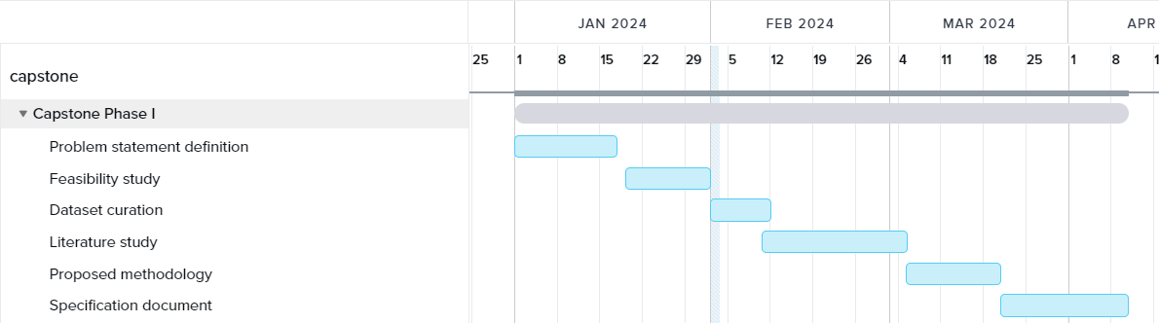
TIME LINE
Gantt Chart

Slide 18
THANK YOU

